Slide 1
Sorting

Slide 2
Sorting
Sorting refers to arranging data in a particular format.
Sorting algorithm specifies the way to arrange data in a particular order.
Most common orders are numerical or lexicographical order.
Importance of sorting lies in the fact that data searching can be optimized to a very high level if data is stored in a sorted manner.
Sorting is also used to represent data in more readable formats.
Some of the examples of sorting in real life
  Telephone Directory , Dictionary

Slide 3
In-place sorting and Not-in-place
Sorting algorithms may require some extra space for comparison and temporary storage of few data elements.
These algorithms do not require any extra space and sorting is said to be happened in-place, or for example, within the array itself. This is called in-place sorting. Bubble sort is an example of in-place sorting.
But in some sorting algorithms, the program requires space which more than or equal to the elements being sorted.
Sorting which uses equal or more space are called not-in-place sorting. Merge-sort is an example of not-in-place sorting.

Slide 4
Bubble sort
Bubble sort is a simple sorting algorithm.
This sorting algorithm is comparison based algorithm in which each pair of adjacent elements is compared and elements are swapped if they are not in order.
This algorithm is not suitable for large data sets as its average and worst case complexity are of O(n²) where n are no. of items.

Slide 5



How bubble sort works?
Bubble sort starts with very first two elements, comparing them to check which one is greater.
In this case, value 33 is greater than 14, so it is already in sorted locations. Next, we compare 33 with 27
We find that 27 is smaller than 33 and these two values must be swapped

Slide 6
for(i = 0; i <n; i++){
for(j = 0; j <n-1; j++){
if (a[j] > a[j+1]){
temp=a[j];
a[j]=a[j+1];
a[j+1]=temp;
}
}

Slide 7
program
void main(){
int i, j, n, temp,p;
int a[10];
printf("\n enter number n:");
scanf("%d", &n);
for(i=0; i<n; i++)
scanf("%d", &a[i]);
p=1;
for(i = 0; i <n; i++){
for(j = 0; j <n-1; j++){
if (a[j] > a[j+1]){
temp=a[j];
a[j]=a[j+1];
a[j+1]=temp;
}
}
printf("\n sorted:%d", a[n-p]);
p++;
}
printf("\n sorted items are:\n");
for(i=0; i<n; i++){
printf("%d\t", a[i]);
}
getch();
}

Slide 8
Insertion Sorting
Idea: like sorting a hand of playing cards start with an empty left hand and the cards facing down on the table.
Remove one card at a time from the table, and insert it into the correct position in the left hand.
Compare it with each of the cards already in the hand, from right to left.
The cards held in the left hand are sorted Suppose an array a[n] with n elements. The insertion sort works as follows:
pass 1: a[0] by itself is trivially sorted.
Pass 2: a[1] is inserted either before or after a[0] so that a[0], a[1] is sorted.
Pass 3: a[2] is inserted into its proper place in a[0],a[1] that is before a[0], between a[0] and a[1], or after a[1] so that a[0],a[1],a[2] is sorted.
….....................................................
pass N: a[n-1] is inserted into its proper place in a[0],a[1],a[2],........,a[n-2] so that
a[0],a[1],a[2],............,a[n-1] is sorted with n elements.

Slide 9
Example of insertion sort
8
2
4
9
3
6

Slide 10
Example of insertion sort
8
4
9
3
6
2

Slide 11
Example of insertion sort
8
2
4
9
3
6
2
8
4
9
3
6

Slide 12
Example of insertion sort
8
2
4
9
3
6
2
8
4
9
3
6

Slide 13
Example of insertion sort
8
2
4
9
3
6
2
8
4
9
3
6
2
4
8
9
3
6

Slide 14
Example of insertion sort
8
2
4
9
3
6
2
8
4
9
3
6
2
4
8
9
3
6

Slide 15
Example of insertion sort
8
2
4
9
3
6
2
8
4
9
3
6
2
4
8
9
3
6

Slide 16
Example of insertion sort
8
2
4
9
3
6
2
8
4
9
3
6
2
4
8
9
3
6
2
4
8
9
3
6
2
3
4
8
9
6

Slide 17
Example of insertion sort
8
2
4
9
3
6
2
8
4
9
3
6
2
4
8
9
3
6
2
4
8
9
3
6
2
3
4
8
9
6
2
3
4
6
8
9
done

Slide 18
Algorithm
Step 1: Repeat 2 to 4 for p=1 to n-1
Step 2: set key = a[p], j= p-1
Step 3: Repeat while temp <A[j]
-a[j+1]=a[j];
  -J=J-1 [end loop]
Step 4: a[j+1]=temp;
Step 5: Return

Slide 19
Void Insertsort(int a[], int n)
{
int p, j, temp;
for(p=1; p<n; p++)
{
temp=a[p];
for(j=p-1; j>=0&&temp<a[j]; j--)
a[j+1]= a[j]
}
a[j+1]=temp;
}

Slide 20
Time Complexity
Wort case Analysis: Array elements are in reverse sorted order
Inner loop executes for 1 times when i=1, 2, times when i=2…. And n-1 times when i=n-1;
Time complexity=1+2+3+………………+(n-2)+(n-1)=n(n-1)/2
=O(n2)
Best Case Analysis:
Array elements are already sorted , the inner loop has single comparison, so inner loop is constant
Inner loop executes for 1 times when i=1, 1 times when i=2………………….. And 1 times when i=n-1; O(n)
Time complexity =1+2+3+………………1+1
Space complexity:
No extra space besides 5 variables is needed for sorting
Space complexity =O(1).

Slide 21
Shell Sort
Shell sort is an improvement on the simple insertion sort.
It is also called as diminishing increment sort.
In insertion sort, we move elements only one position ahead.
When an element has to be moved far ahead, many movements are involved.
The idea of shell Sort is to allow exchange of far items.

Slide 22
example
25 57 48 37 12 92 86 33
First find the interval let’s say gap =(floor)N/2 =8/2=4
Here gap is 4 at pass 1 we compare and swap
(0, 4) , (1, 5), (2, 6), (3, 7)

Slide 23
Function
for(gap=n/2; gap>=1; gap/2){
for(j=gap; j<n; j++){
for(i=j-gap; i>=0; i=i-gap){
if(a[i+gap]>a[i]){
break;
}
else{
int temp;
temp=a[i+gap];
a[i+gap]=a[i];
a[i]=temp;
}
}}}

Slide 24
Complexity
Time Complexity: Time complexity of above implementation of shell sort is O(n²).
In the above implementation gap is reduce by half in every iteration. There are many other ways to reduce gap which lead to better time complexity.

Slide 25
Selection sort
Consider an array a with n elements a[0] to a[n-1].
The selection sort algorithm for sorting a[] works as:
First find the smallest elements in the list and put it in the first position.
Then find the second smallest element and put it in second position and so on i.e.
In first pass find the location L o fthe smallest in the list of n elements and then interchange a[L] with a[0]. So a[0] is sorted.
In Second pass find the location L of the smallest in the list of n-1 elements and then interchange a[L] with a[1]. So a[1] is sorted i.e. a[0]<=a[1] and so on.

Slide 26
Algorithm :Selection Sort
Input: An array a of n elements
Output: sorted a of n elements.
1. Loop for pass
Repeat step 2 to 4 for pass=0 to n-2
2. Initialize
min_index=pass.
min=a[pass];
3. For i=pass+1 to n-1 do
if a[i]<a[min_index] then min_index=I;
4. Exchange if(min_index!=pass) then
a[pass]=a[min_index]
5. Return a[min_index]=min;

Slide 27
Tracing Algorithm
A[]={40, 66, 93, 8, 12, 44, 6, 88, 60}
Pass | a[0] | a[1] | a[2] | a[3] | a[4] | a[5] | a[6] | a[7] | a[8]
pass=0, min_index=6 | 40 | 66 | 93 | 8 | 12 | 44 | 6 | 88 | 60
pass=1, min_index=3 | 6 | 66 | 93 | 8 | 12 | 44 | 40 | 88 | 60
pass=2, min_index=4 | 6 | 8 | 93 | 66 | 12 | 44 | 40 | 88 | 60
pass=3, min_index=6 | 6 | 8 | 12 | 66 | 93 | 44 | 40 | 88 | 60
pass=4, min_index=5
pass=5, min_index=8
pass=6, min_index=-
pass=7, min_index=-

Slide 28
C function for selection Sort
Void selectionSort(in a[], int n){
int pass, min_index, i, min;
for(pass=0; pass<n-1; pass++){
min_index=pass;
min=a[pass];
for(i=pass+i; i<n-1; i++){
if(a[i]<a[min_index]){
min_index=i;
}
}
if(min_index!=pass){
a[pass]=a[min_index];
a[min_index]=min;
}
} //for end
} //end selection sort

Slide 29
Complexity for selection sort
The first pass makes n-1 comparison second pass makes n-2 comparisons and son on.
The total of
F(n)=(n-1)+(n-2)+ ………. +2+1 = n*(n-1)/2
= O(n2).
No improvements if the input is completely sorted or unsorted since testing is made in each case.
It is suitable for small n.

Slide 30
Quick Sort
In practice this is the fastest sorting method.
It possesses very good average case complexity among all the sorting algorithms.
This algorithm is based on the divide and conquer paradigm.
The main idea behind this sorting is partitioning of the elements.

Slide 31
Steps for Quick Sort
Divide: partition the array into two nonempty sub arrays.
Conquer: two sub arrays are sorted recursively.
Combine: two sub arrays are already sorted in place so no need to combine.

Slide 32
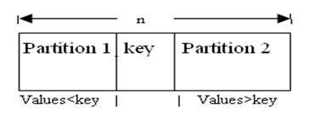
Cont…

Slide 33
QuickSort(A,l,r)
{
f(l<r)
{
p = Partition(A,l,r);
QuickSort(A,l,p-1);
QuickSort(A,p+1,r);
}
}

Slide 34
Partition(A,l,r)
{
x =l; y =r ;
p = A[l];
while(x<y)
{
while(A[x] <= p)
x++;
while(A[y] >=p)
y--;
if(x<y)
swap(A[x],A[y]);
}
A[l] = A[y]; A[y] = p;
return y; //return position of pivot
}

Slide 35
Time Complexity
Best Case:
Divides the array into two partitions of equal size, therefore
T(n) = 2T(n/2) + O(n) ,
Solving this recurrence we get,
T(n)=O(nlogn)
Worst case:
when one partition contains the n-1 elements and another partition contains only one element. Therefore its recurrence relation is:
T(n) = T(n-1) + O(n),
Solving this recurrence
we get T(n)=O(n2)

Slide 36
Average case
Good and bad splits are randomly distributed across throughout the tree T1(n)= 2T'(n/2) + O(n) Balanced
T'(n)= T(n –1) + O(n) Unbalanced
Solving:
B(n)= 2(B(n/2 –1) + Θ(n/2)) + Θ(n) = 2B(n/2 –1) + Θ(n)
= O(nlogn) =>T(n)=O(nlogn)

Slide 37
Merge Sort
Divide
Divide the n-element sequence to be sorted into two sub-sequences of n/2 elements
Conquer
Sort the sub-sequences recursively using merge sort.
When the size of the sequences is 1 there is nothing more to do
Combine
Merge the two sorted sub-sequences

Slide 38
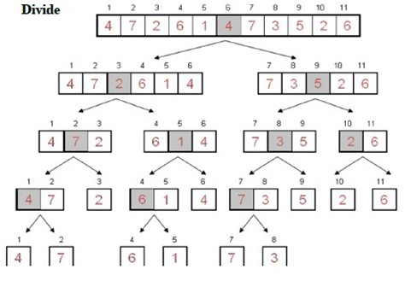
Example: a[]={4, 7, 2, 6, 1, 4, 7, 3, 5, 2, 6}

Slide 39
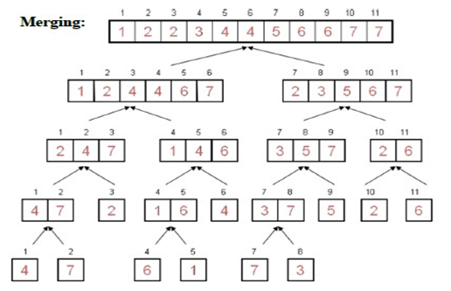

Slide 40
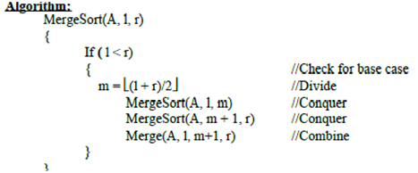

Slide 41
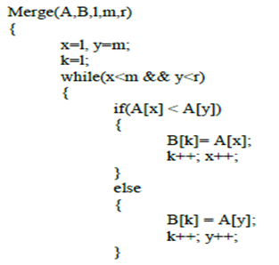

Slide 42
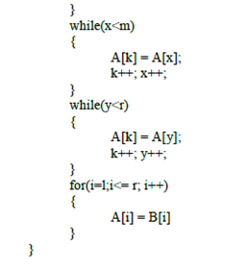

Slide 43
Time Complexity
Recurrence Relation for Merge sort:
T(n) = 1 if n=1
T(n) = 2 T(n/2) + O(n)
if n>1 Solving this recurrence we get T(n) = O(nlogn)
Space Complexity:
It uses one extra array and some extra variables during sorting, therefore Space Complexity= 2n + c = O(n)

Slide 44
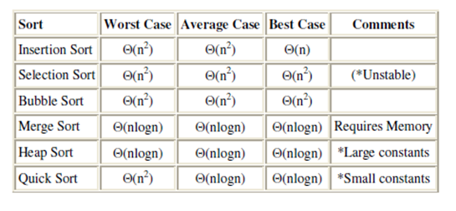
Sorting Comparison

Slide 45
Searching
a) Introduction
b) Sequential search
c) Binary search
d) Comparison and efficiency of searching e) Hashing
  probing (Linear and Quadratic)

Slide 46
Introduction
Sequential Search:
In linear search, access each element of an array one by one sequentially and see whether it is desired element or not.
A search will be unsuccessful if all the elements are accessed and the desired element is not found.
In brief, Simply search for the given element left to right and return the index of the element, if found. Otherwise return “Not Found”.
Searching is a process of finding an element within the list of elements stored in any order or randomly.
Searching is divided into two categories Linear and Binary search.

Slide 47
Algorithm
LinearSearch(A, n, key)
{
for(i=0; i<n; i++)
{
if(A[i] == key)
return i;
}
return -1; //-1 indicates unsuccessful search
}
Analysis
Time complexity = O(n)

Slide 48
Binary Search
Binary search is an extremely efficient algorithm. This search technique searches the given item in minimum possible comparisons.
To do this binary search, first we need to sort the array elements.

Slide 49
The logic
First find the middle element of the array compare the middle element with an item.
There are three cases
If it is a desired element then search is successful
If it is less than desired item then search only the first half of the array.
If it is greater than the desired element, search in the second half of the array.
Repeat the same process until element is found.
In this algorithm every time we are reducing the search area.

Slide 50
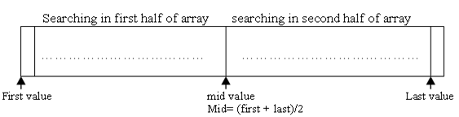

Slide 51
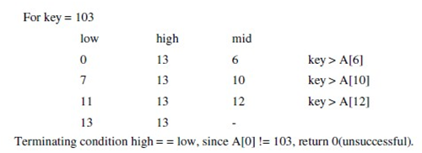
Take input array a[] = {2 , 5 , 7, 9 ,18, 45 ,53, 59, 67, 72, 88, 95, 101, 104}

Slide 52
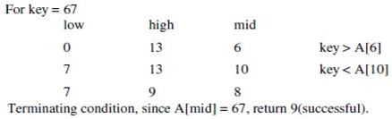
a[] = {2 , 5 , 7, 9 ,18, 45 ,53, 59, 67, 72, 88, 95, 101, 104}

Slide 53
Algorithm
BinarySearch(A,l,r, key)
{
if(l= = r) //only one element
{
if(key = = A[l])
return l+1; //index starts from 0 else
return 0;
}
else
{
m = (l + r) /2 ; //integer division if(key = = A[m]
return m+1;
else if (key < A[m])
return BinarySearch(l, m-1, key) ;
else
return BinarySearch(m+1, r, key) ;
}
}

Slide 54
Efficiency
From the above algorithm we can say that the running time of the algorithm is
T(n) = T(n/2) + (1)
= (logn) (verify).
In the best case output is obtained at one run i.e. (1) time if the key is at middle.
In the worst case the output is at the end of the array so running time is (logn) time.ith
In the average case also running time is (logn).
For unsuccessful search best, worst and average time complexity is (logn).

Slide 55
Hashing
It is an efficient searching technique in which key is placed in direct accessible address for rapid search.
Hashing provides the direct access of records from the file no matter where the record is in the file. Due to which it reduces the unnecessary comparisons. This technique uses a hashing function say h which maps the key with the corresponding key address or location.
A function that transforms a key into a table index is called a hash function. A common hash function is h(x)=x mod SIZE
if key=27 and SIZE=10 then hash address=27%10=7

Slide 56
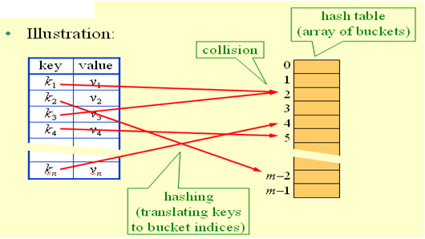
Hash-table principles

Slide 57
Hash collision
If two or more than two records trying to insert in a single index of a hash table then such a situation is called hash collision.
Some popular methods for minimizing collision are:
  Linear probing
  Quadratic probing
  Rehashing
  Chaining
  Hashing using buckets etc
But here we need only first two methods for minimizing collision

Slide 58
Linear probing
A hash-table in which a collision is resolved by putting the item in the next empty place within the occupied array space.
It starts with a location where the collision occurred and does a sequential search through a hash table for the desired empty location.
Hence this method searches in straight line, and it is therefore called linear probing.
Disadvantage:
Clustering problem

Slide 59
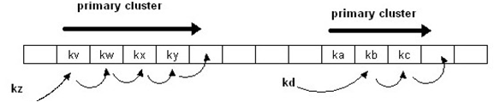

Slide 60
Eg.
Insert keys {89, 18, 49, 58, 69} with the hash function
h(x)=x mod 10 using linear probing.
solution:
when x=89: h(89)=89%10=9
insert key 89 in hash-table in location 9
when x=18: h(18)=18%10=8
insert key 18 in hash-table in location 8

Slide 61
when x=49:
h(49)=49%10=9 (Collision occur)
so insert key 49 in hash-table in next possible vacant location of 9 is 0
when x=58:
h(58)=58%10=8 (Collision occur)
insert key 58 in hash-table in next possible vacant location of 8 is 1 (since 9, 0 already contains values).
when x=69:
h(89)=69%10=9 (Collision occur)
insert key 69 in hash-table in next possible vacant location of 9 is 2 (since 0, 1 already contains values).

Slide 62
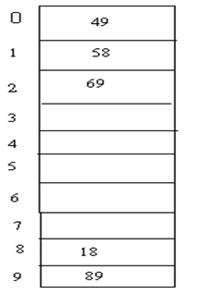
Fig. Hash-table for above keys using linear probing

Slide 63
Quadratic Probing
Quadratic probing is a collision resolution method that eliminates the primary clustering problem take place in a linear probing.
When collision occur then the quadratic probing works as follows: (Hash value + 12)% table size
if there is again collision occur then there exist rehashing. (hash value + 22)%table size
if there is again collision occur then there exist rehashing. (hash value = 32)% table size in general in ith collision
hi(x)=(hash value +i2)%size

Slide 64
Example:
Insert keys {89, 18, 49, 58, 69} with the hash-table size 10 using quadratic probing. solution:
when x=89: h(89)=89%10=9
insert key 89 in hash-table in location 9
when x=18: h(18)=18%10=8
insert key 18 in hash-table in location 8
when x=49:
h(49)=49%10=9 (Collision occur) so use following hash function, h1(49)=(49 + 1)%10=0
hence insert key 49 in hash-table in location 0

Slide 65
when x=58:
h(58)=58%10=8 (Collision occur) so use following hash function, h1(58)=(58 + 1)%10=9
again collision occur use again the following hash function , h2(58)=(58+ 22)%10=2
insert key 58 in hash-table in location 2
when x=69:
h(89)=69%10=9 (Collision occur) so use following hash function, h1(69)=(69 + 1)%10=0
again collision occur use again the following hash function , h2(69)=(69+ 22)%10=3
insert key 69 in hash-table in location 3

Slide 66
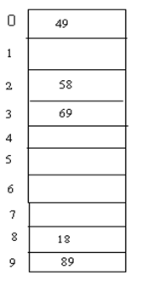
fig: Hash table for above keys using quadratic probing

